Slide 1
Chapter 4
Knowledge Representation Issue

Slide 2
Representations and Mapping
For complex problems, AI needs a large amount of knowledge and some mechanisms for manipulation that knowledge to create solutions to new problems.
Two different kinds of entities:
i) Facts: truths in some relevant world.
ii) Representation of facts in some chosen formalism.
One way to structuring these entities is as two levels:
i) The knowledge level, at which facts are described.
ii) The symbol level, at which representations of objects at the knowledge level are defined in terms of symbols that can be manipulated by programs.

Slide 3
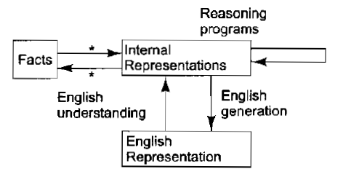
Representations and Mapping
We will focus on facts, on representations, and on the two-way mappings that must exist between them.
This links are known as representation mappings.
The forward representation mapping maps from facts to representation.
The backward representation mapping goes the other way, from representation to fact.

Slide 4

Representations and Mapping
Representation of Facts is natural language.
E.g. spot is a dog.
dog(spot). (fact represented in logic)
Logical representation
hastail(spot).
spot has a tail.

Slide 5
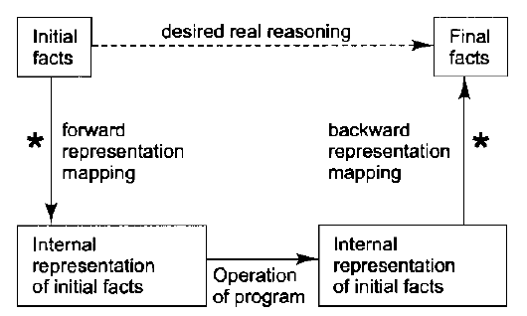
Representations and Mapping
The dotted line across the top represents the abstract reasoning process that a program is intended to model.
The solid line across the bottom represents the concrete reasoning process that a particular program performs.
The key role that is played by the nature of the representation mapping is apparent from this figure.
If no good mapping can be defined for a problem, then no matter how good the program to solve the problem is, it will not be able to produce answers that correspond to real answers to the problem.

Slide 6
Approaches to Knowledge Representation
Four Properties:
Representational Adequacy
The ability to represent all of the kinds of knowledge that are needed in that domain.
Inferential Adequacy
The ability to manipulate the representational structures in such a way as to derive new structures corresponding to new knowledge inferred from old.
Inferential Efficiency
The ability to incorporate into the knowledge structure additional information that can be used to focus the attention of the inference mechanisms in the most promising directions.
Acquisitional Efficiency
The ability to acquire new information easily. The simplest case involves direct insertion, by a person, of new knowledge into the database. Ideally, the program itself would be able to control knowledge acquisition.

Slide 7
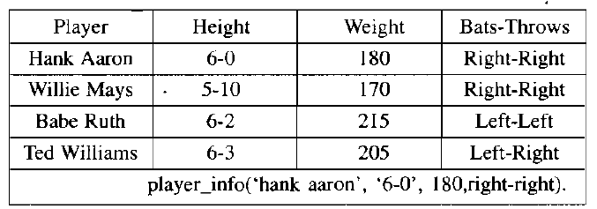
Conti.
Simple Relational Knowledge
The simplest way to represent declarative facts is as a set of relations of the same sort used in database systems.

Slide 8
Conti.
The reason that this representation is simple is that standing alone it provides very weak inferential capabilities, but knowledge represented in this form may serve as the input to more powerful inference engines.

Slide 9
Conti.
2) Inheritable knowledge
One of the most useful forms of inference is property inheritance, in which elements of specific classes inherit attributes and values from more general classes in which they are included.
In order to support property inheritance, objects must be organized into classes and classes must be arranged in generalization hierarchy.
Referring to the figure on next slide.
Lines represent attributes.
Boxed nodes represent objects and values of attributes of objects.
Arrows point from object to its value along the corresponding attribute line.

Slide 10
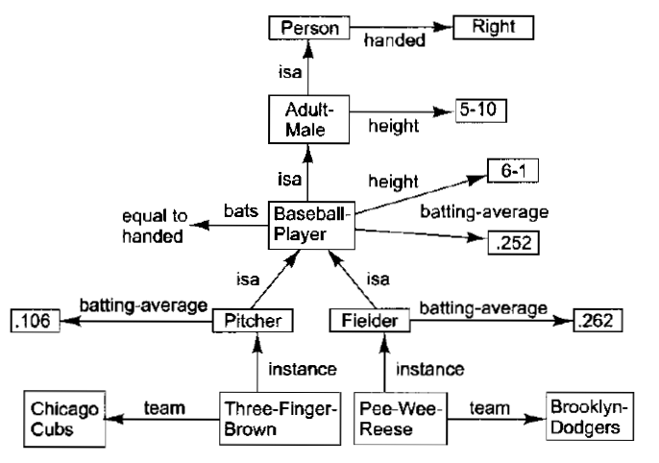
Conti.
This structure is a slot-and-filler structure. Also known as Semantic network.
Figure shows the node for baseball player displayed as a frame.

Slide 11
Conti.
3) Inferential Knowledge
The inferential knowledge approach represents knowledge in the form of formal logic. Thus, it can be used to derive more facts. Also, it guarantees correctness.
E.g. Statement 1: John is a cricketer.
Statement 2: All cricketers are athletes.
Then it can be represented as;
Cricketer(John)
∀x = Cricketer (x) ———-> Athelete (x)s

Slide 12
Conti.
4) Procedural Knowledge
This type of knowledge is more complex than declarative knowledge as it refers to a more complex idea, i.e., how things behave and work.
Thus this knowledge is used to accomplish any task using certain procedures, rules, and strategies, making the system using this knowledge work efficiently.
Also, this type of knowledge highly depends on the task we are trying to accomplish.

Slide 13
Issues in Knowledge Representation
Important Attributes
There are two attributes that are of very general significance, and we have already seen their use: Instance and isa
These attributes are important because they support property inheritance.
They represent class membership and class inclusion and that class inclusion is transitive.

Slide 14
Conti.
Relationship among Attributes
The attributes that we use to describe objects are themselves entities that we represent. There are four such properties that deserve mention here:
Inverses
Existence in an isa hierarchy
Techniques for reasoning about values
Single-valued attributes

Slide 15
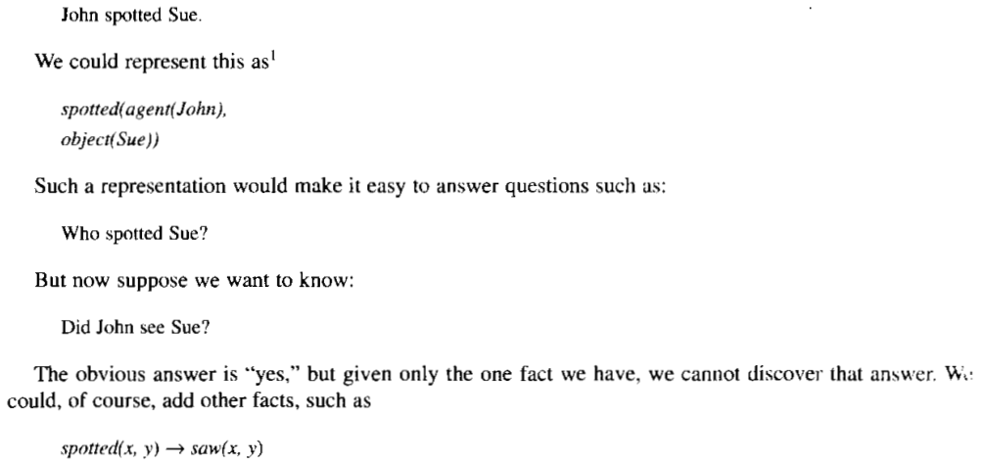
Conti.
Choosing the Granularity of Representation
Suppose we are interested in the following fact:

Slide 16
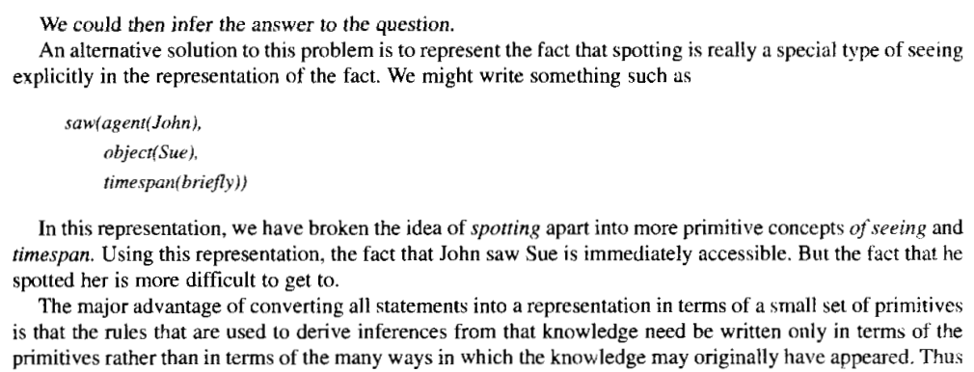
Conti.

Slide 17

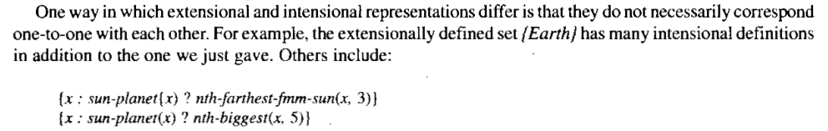
Conti.
Representing Sets of Objects
There are three ways to represent sets
By a name
Extensional definition (To list the members)
Intensional Definition (Provide Rules)
e.g.

Slide 18
Conti.
Finding the right Structures as Needed
Selecting an initial Structure
Revising the choice when necessary

